Slide 1
Moderator briefing
September 5th, 2023

Slide 2
September 21- 23, 2023
Seattle, WA
Health Technology & Solutions | Digital Patient Experience | Business of Digital Health
Clinicians, Scientists, Entrepreneurs, Executives,
Investors ( Strategics, VCs), Engineers, Product Developers, Thought Leaders
Health Tech, Med Device, Health Care Systems, Universities, Consumer Tech

Slide 3
Defined by the past, shaped by the present, propelled by the future
The narrative:
HRX is the only cardiovascular digital health conference designed to bring together various groundbreaking perspectives in one dynamic venue. Expertly curated to provoke thought and inspire collaboration, HRX is building a community of compassionate digital health innovators dedicated to advancing technological approaches to cardiovascular digital health.
Unlike other conferences, HRX provides an intimate, collaborative setting that brings together the best and the brightest from healthcare and technology.
HRX is explicitly designed to propel strategic brainstorming on how innovations in cardiovascular digital healthcare will impact the present and future. This includes creating a generative space for thought leadership, formal and informal dialogue, collaboration, and the exchange of groundbreaking ideas. By convening clinicians, engineers, product developers, investors, entrepreneurs and patient advocacy groups, we provide a platform to examine the latest digital health advancements, share respective challenges while envisioning future solutions. You may learn more about HRX by visiting experiencehrx.com.
The Audience:
Clinicians
Engineers, Developers, Technologists
Investors, Entrepreneurs
Researchers, and Engineers
Hospitals/large health care systems,
RPM, SaaS/Enterprise Companies
Government: FDA, NIH
Executives, Investors
MedTech, Tech, Health Tech, Big Tech
The phenotype: Decision-Makers, Influencers, Experts, Innovators, Entrepreneurs, and
Solution- Driven Leaders

Slide 4
TEAM HRX
Executive Producers:
Sana Al-Khatib, MD, MHS, FHRS, CCDS
Jag Singh, MD, PhD, FHRS
Producer: Jennifer N. Avari Silva, MD, FHRS, CEPS-P
The Streams
Business of Digital Health Content Team:
Nassir Marrouche, MD; Janet Han, MD; Hamid Ghanbari, MD; Adrian Hernandez, MD;
Kenneth Nelson; Noemi Ray
Digital Patient Experience Content Team:
Suneet Mittal, MD; Brynn Dechert-Crooks, APN, FHRS, CCDS; Abhinav Sharma, MD;
Manish Wadhwa, MD, Sacchin Vadodaria
Health Technology & Solutions Content Team:
Rod Passman, MD; Andrew Sauer, MD; Jodi Eddy; Sanjiv Narayan, MD; Collin Stultz, MD

Slide 5
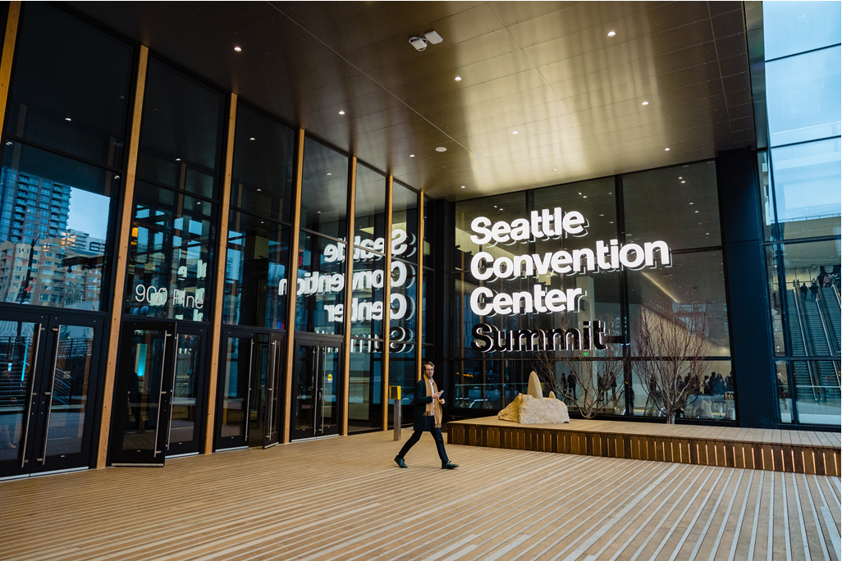
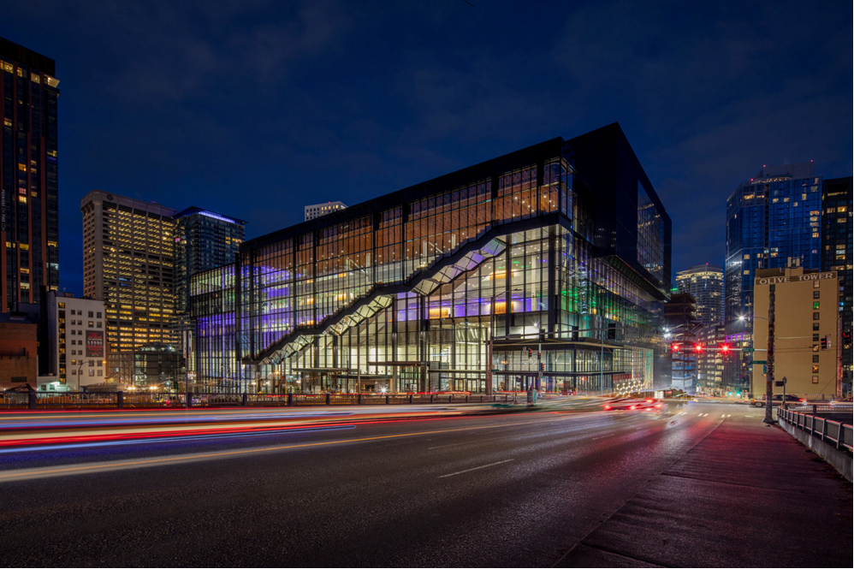
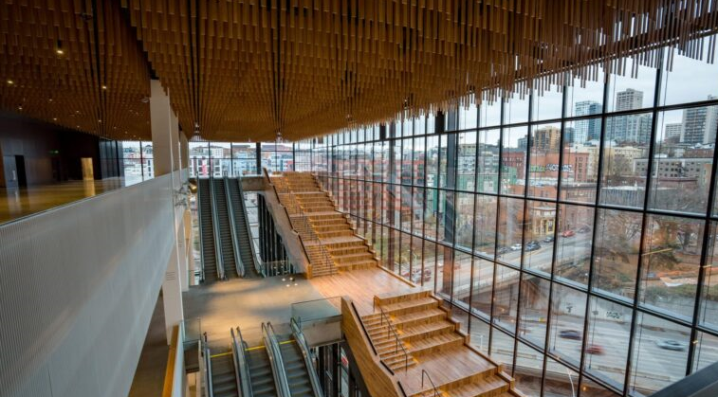
The Venue
The Summit in Seattle

Slide 6
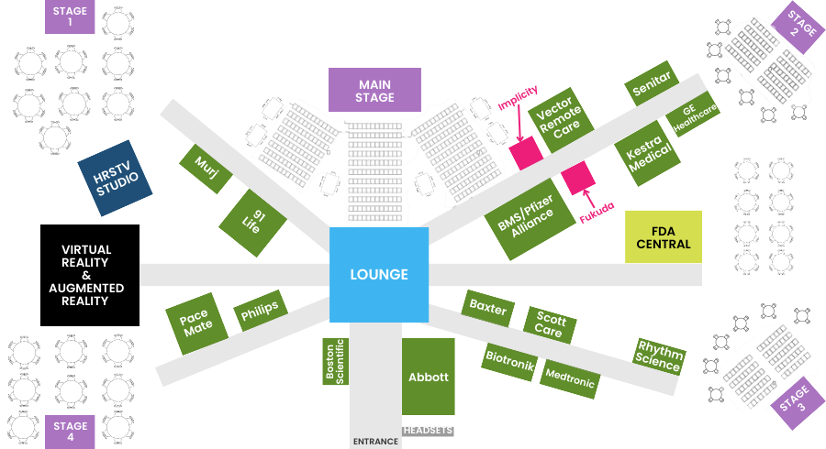
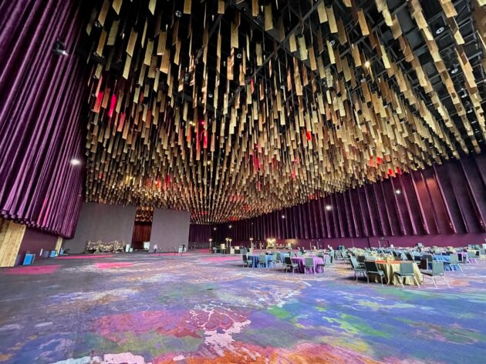
Floorplan The Experience

Slide 7
The Program
HRX purposefully brings together a unique and diverse mix of experts to create the perfect environment for meaningful connection. In this exclusive and intimate setting, one can expect more engaging conversations with more intentional connections that further your goals.
Three Streams
Business of Digital Health, Digital Patient Experience, and Health Technology & Solutions
Main Tent – One stage, one show, everything else is suspended
Highest profile speakers and moderators
Key names in the field and thinkers/influencers/authors with brands

Slide 8
Main Tent Sessions In Program
Main Tent Sessions
Partnered with platinum sponsors to deliver main tent sessions with multiple speakers:
Applying Digital Health Solutions to Achieve Wellness
Using Digital Technology to Reduce Bias, Racism and Health Inequities
Debate: Digital Health is Undermining the Practice of Clinical Medicine
The Top Digital Health Innovations that Will Transform Healthcare

Slide 9
Main Tent Sessions
During main tent sessions there will be no other sessions running concurrently. In this 1-hour session, visionary speakers will have the opportunity to present on the selected topic on HRX’s main stage. The session moderator will facilitate the discussion and manage questions from the audience.
Moderators:
There is no need for you to create slides
Review the session descriptions to assist with discussion
Introduce the speakers and keep the session flowing
Panelists:
No slides necessary

Slide 10
Fireside Chats In Program
Fireside Chat with Abraham Verghese – Preserving Humanism in Medicine in a Rapidly Transformational Digital World
Fireside Chat - Joanna Pena Bickley, Head of Research & Design, Alexa Devices at Amazon
Fireside Chat – Women Executives in Health Tech

Slide 11
Fireside Chat Sessions
During Fireside Chats, there will be no other sessions running concurrently. These session are 1:1 moderated interviews with a luminary. In this 1-hour session, a moderator will have the opportunity to facilitate a discussion with a luminary on the conference’s main stage.
Moderators:
There is no need for you to additional slides.
Introduce the speakers and keep the session flowing
Speakers:
No slides necessary

Slide 12
Group Chats In Program
FDA 101
Utilizing Virtual Care for Patient Follow Up: A True Focus on Quality of Life
Digital Biomarkers and Therapeutics – How will they look in 2022 and 2030?
Using Digital Health to Improve Access to Care Especially for Disadvantaged Patients
Investing in the Digital Health Revolution Post Silicon Valley Bank Failure
Is Sensor Technology the Fashion of the Future?
From Health Kiosks to Home Care Models – Meeting Patients Wherever They Want to be Seen
AI-aided Remote Interventions – Will this Transform Healthcare Delivery & Outcomes
The FemTech Business Revolution: Opps for Women’s Cardiovascular Health
Ensuring Optimal Data Sharing While Protecting Data Privacy
Artificial Intelligence in All Aspects of Remote Patient Monitoring Care
The Pearls and Perils of the Metaverse in Medicine
Living the Journey – Premonition to Prototype to Product to Practice
Reaching Across the Aisle – Multidisciplinary Digital Approach to Heart Failure – A Better Business Model?

Slide 13
Group Chat Sessions
Group Chats are panel discussions with KOLs sharing insights and solutions
Moderator Role:
Introduce the topic and each speaker
Keep the session on time
Remind audience to use the mobile app to ask questions or mics in the audience
Questions from the audience will be posed via the mobile app and audience mics; moderators will manage Q&A
Opportunity to provide resources for attendees via mobile app

Slide 14
360 Workshops In Program
360 Workshops:
Large Language Models – What Does this Mean for the Practice of Medicine
Expanding the Remote Care Paradigm - How Far Can We Go?
Multidisciplinary Virtual Care & the Virtual Hospital - Fact or Fantasy?
Digital Twins and Command Stations - Whether the Twain Shall Meet?
360 Workshop

Slide 15
360 Workshop
Concurrent sessions providing a deeper dive into a focused topic. In these interactive, small- group discussions, a diverse group of attendees work together to offer insights, identify pitfalls, and share experiences in response to a selected topic, invention, or product.
Moderators:
Introduce the topic and each facilitator
Keep the session on time
Remind audience to use the mobile app to ask questions or mics in the audience

Slide 16
Incubator Lounges In Program
Incubator Labs:
Improve Your Pitch
My Car - Can it be my Sentinel?
Engineers are from Mars, Clinicians are from Venus

Slide 17
Incubator Lounges
In this session, small groups of attendees join facilitators to incubate solutions around a specific challenge or problem.
Moderators:
Introduce discussants
Introduce topics
Keep discussion moving between presenters and any audience input

Slide 18
AbstracX Three AbstracX Sessions
Brief (5 minutes, 3 slides) oral presentations of accepted abstracts.
Presenting author for each abstracX will be on one of the 3 stages during the abstracX presentation times.
Each presenting author will offer a 5-minute overview using no more than 3 slides to showcase their research.
There is a 5-minute time between each presenter in which a question may be posed to the author.
Moderator will keep session flowing and timing organized.
If further Q&A is desired, authors may move to the 4th stage area for audience interaction.

Slide 19
Thank You

